Slide 1

Implementation Guidelines:
Structured Pedagogy
EARLY GRADE READING SYNTHESIS AND LESSONS
Presentation by: KHOLOSA NONKENGE
Organisation: DBE
Date: 3 July 2025

Slide 2

Implementation Guidelines
EARLY GRADE READING SYNTHESIS AND LESSONS
Daily Scripted Lesson
Teacher Development
Coaching
Technology and Communication
Learning and Teaching Support Materials

Slide 3

Daily Scripted Lesson Plans
EARLY GRADE READING SYNTHESIS AND LESSONS
Lessons
STRUCTURE:
Essential in resource-limited contexts, helps plan curriculum coverage, allocate time for activities and skills
DELIVERY:
Daily lesson plans need to be delivered to teachers on time.
TECHNOLOGY:
Providing the lesson plans on tablets did not appear to affect the impact of the intervention.

Slide 4

Daily Scripted Lesson Plans
EARLY GRADE READING SYNTHESIS AND LESSONS
Recommendations
CAPS Alignment
Build lesson plans based on existing good ones
Make lesson plans accessible online for teachers to use and print as needed
Ensure explicit incorporation of LTSM provided through the programme

Slide 5

Learning and Teaching Support Materials (LTSM)
EARLY GRADE READING SYNTHESIS AND LESSONS
Lessons
Grade readers
  Provide a clear progression in difficulty, helping teachers to systematically build students' reading skills.
  Graded Readers also assist with Group Guided Reading by providing the teachers with opportunities to provide individualised attention to learners.
Curriculum Trackers
  Help monitor and support implementation of the curriculum.
  Help teachers stay organised and focused on their instructional goals, and provide them with a clear framework to follow.

Slide 6
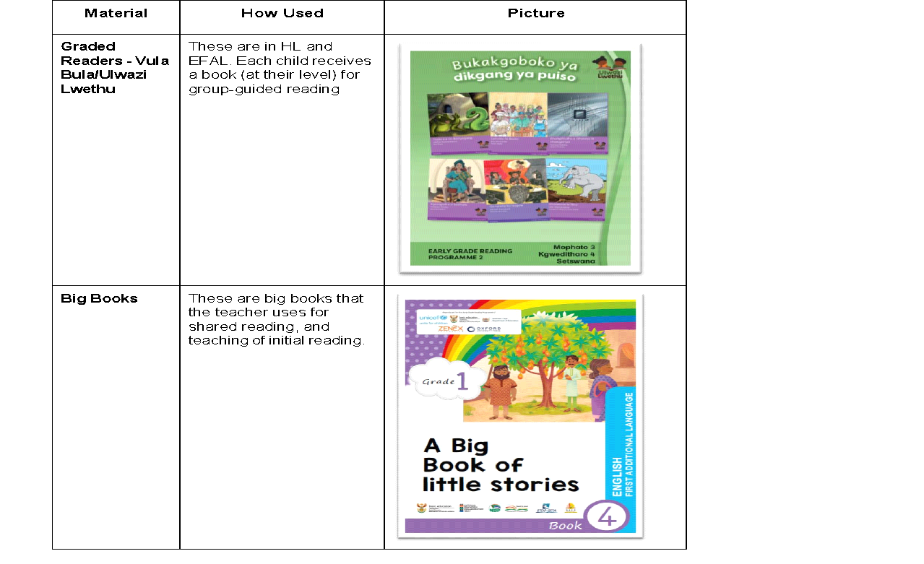

LTSM
EARLY GRADE READING SYNTHESIS AND LESSONS
Notes:
Table A2: Table with descriptions and examples of types of additional LTSM

Slide 7


LTSM
EARLY GRADE READING SYNTHESIS AND LESSONS
Recommendations
1
Link LTSM to lesson plans
For alignment between the provided LTSM and the resources referenced in the lesson plans.
2
Provide curriculum-aligned trackers as part of LTSM
Curriculum trackers have proven very relevant to supporting teachers while at the same time, monitoring curriculum coverage.
3
Graded Readers
Provide age-appropriate readers and train teachers on how to make use of them.

Slide 8

TEACHER DEVELOPMENT
EARLY GRADE READING SYNTHESIS AND LESSONS
Lessons
Centralised (JiT) Teacher training
To ensure that teachers receive immediate, consistent, ongoing & standardised support.
However,
Trade-offs can be faced when decided on training length.

Slide 9

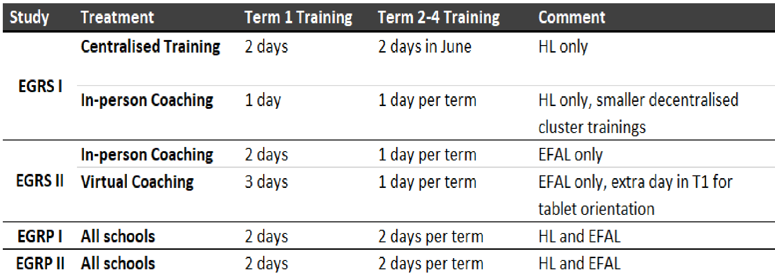
Teacher training
EARLY GRADE READING SYNTHESIS AND LESSONS
Training days in the various EGRS programmes
 | TEXT | TEXT | TEXT
 | Text | Text | Text
Text | Text | Text | Text
Text | Text | Text | Text
Text | Text | Text | Text
Text | Text | Text | Text
Text | Text | Text | Text
Text | Text | Text | Text
Text | Text | Text | Text
Text | Text | Text | Text

Slide 10

Teacher training
EARLY GRADE READING SYNTHESIS AND LESSONS
Recommendations
Ensure that language competency from the trainer aligns with the language for implementation.
Ensure that the teacher training aligns with the DBE’s Professional Teacher Development Frameworks.
Carefully consider context specific requirements when selecting training venues.
Carefully consider cost implications

Slide 11
Coaching
EARLY GRADE READING SYNTHESIS AND LESSONS
Lessons
In-Person:
Coaching is most effective if it is in-person on-site at the school and performed by an externally hired and trained specialist coach.
Coaching norms and standards:
Recruitment: selection & hiring
Employment: Conditions of service.
Coach training and Professional Development
Coach training on both the content, learning approaches as well as the coaching the approach are crucial.

Slide 12

Coaching
EARLY GRADE READING SYNTHESIS AND LESSONS
Recommendations
Create opportunities to observe in classroom practice.
Explore how existing roles can fulfil coaching support functions
Select coaches carefully
Invest in professional in-person coaching

Slide 13
Technology and Communication
EARLY GRADE READING SYNTHESIS AND LESSONS
Lessons
WhatsApp:
WhatsApp has proven to be a very cost-effective tool for engaging teachers and providing remote virtual coaching.
Digital materials:
Provide a significant advantage due to their adaptability, allowing for easy modifications and changes in materials.

Slide 14

Technology and Communication
EARLY GRADE READING SYNTHESIS AND LESSONS
Recommendations
1
Make materials accessible offline
For connectivity especially in remote areas.
2
Consider costs and implications for storage of digital data.
Online servers tend to raise concerns specifically on how the server will be managed and funded post implementation.
3
Evaluate data costs
When considering ICT tools. Carefully explore data zero-rated options.

Slide 15
Thank you

